Slide 1
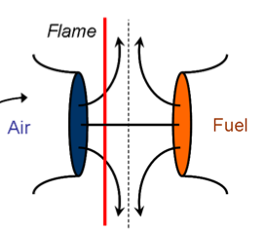
Reaction Models (flame states)
Diffusion flame
Opposed Jet
Stirred Reactor
Air
Fuel
L
Vary Strain through:
L, χ, τ
Heat loss through
unsteady radiation
Notes:
Diffusion flame: Solve in physical space → monotonic with mixture fraction; no velocity (at SS at least). Mixing between one location and the adjacent points.
Opposed jet: the canonical “flamelet” (though that is a generic term). Often solve in mixture fraction coordinate; Implies opposed flow, which can’t happen everywhere in a turbulent flame. Mixing between one location and the adjacent points.
Stirred reactor: one mixture fraction per run; vary strain through residence time tau. Mixing between contents and inlet.
Others are possible, like experimental data, DNS, ODT, LEM, HiPS...

Slide 2
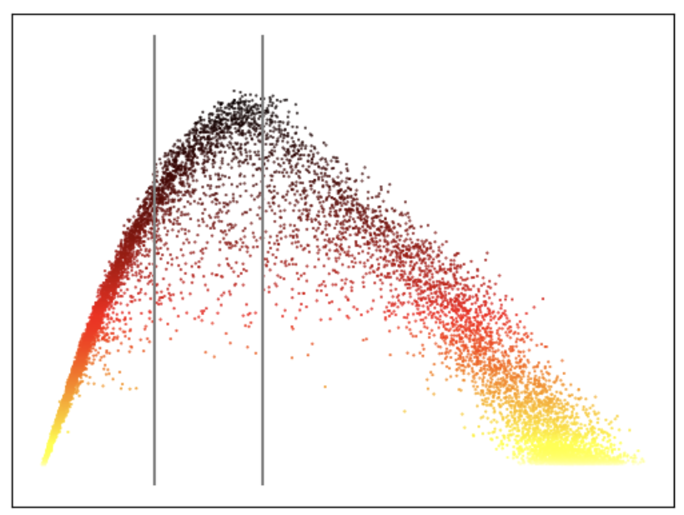
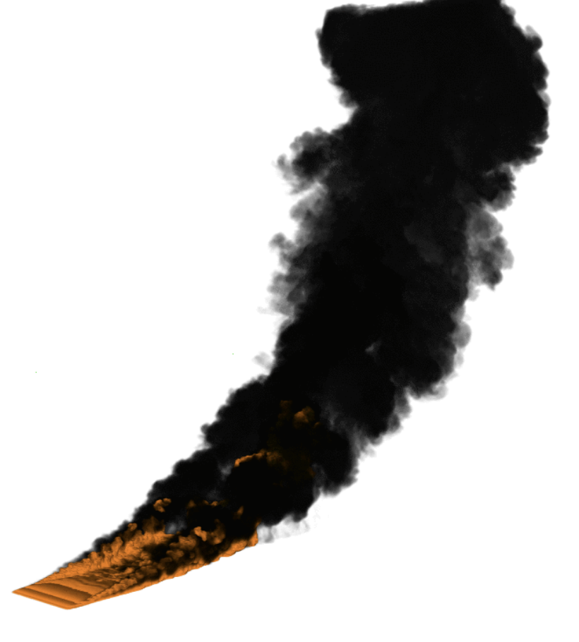
Table generation
Solve diffusion flames
Convolve over P(ξ)
CFD to Table Lookup
Air
Fuel
inversion
L
Vary L
Vary t: Rad. heat loss
Form table for each variable
Including and
φ is, e.g., T, ρ, y_{i}, etc.
interpolation

Slide 3
Laminar flame case structure
Steady Adiabatic | Unsteady Rad HL | Unsteady Rad HL | Unsteady Rad HL
Steady Adiabatic | Unsteady Rad HL | Unsteady Rad HL | Unsteady Rad HL
Steady Adiabatic | Unsteady Rad HL | Unsteady Rad HL | Unsteady Rad HL
(Extinction) | Unsteady Adiabatic | Unsteady Adiabatic | Unsteady Adiabatic
Table parameterized as
φ(ξ, L, t)
where φ is, e.g., T, ρ, y_{i} …
L is the same within each row i
t varies in a given column j
Length, L_{i}
Time, t_{j}
Notes:
The (Extinction) file is the adjacent Steady Adiabatic file, but mapped onto the Extinction domain size.
The table has rectangular indexing but nonuniformly spaced in t

Slide 4
Laminar flame case structure
Vary L: Steady state, then unsteady through extinction
Steady Adiabatic
Steady Adiabatic
Steady Adiabatic
(Extinction) | Unsteady Adiabatic | Unsteady Adiabatic | Unsteady Adiabatic
Length, L_{i}
Time, t_{j}
Notes:
Just noting that the next results are steady, then at extinction unsteady, all adiabatic

Slide 5
Laminar flame profiles: SS with L
Temperature
Progress Variable C=Y_{H2}+Y_{H2O}+Y_{CO}+Y_{CO2}
decreasing L
decreasing L
T is not monotonic in L
C is monotonic in L
Notes:
Steady state temperature and progress variable at varying domain size L.
All are adiabatic.
The progress variable is used to “mark” changes in domain length, since the progress variable is readily obtained from the simulation but we have not way of directly evaluating domain length in the simulation.
We desire a progress variable that is monotonic in L so that we can invert L(C) to obtain C.
Temperature is an obvious choice, but T is not monotonic in L.
C = the sum of mass fractions of H2, H2O, CO, and CO2 is monotonic in L.
C=CO+CO2 works (but the pinch is tighter).
C =CO2+H2O, CO+H2, H2+H2O are not monotonic (strongly so)

Slide 6
Laminar flame case structure
Vary t: Unsteady with radiative heat loss
SS, adiabatic | US, rad HL | US, rad HL | US, rad HL
SS, adiabatic | US, rad HL | US, rad HL | US, rad HL
SS, adiabatic | US, rad HL | US, rad HL | US, rad HL
Length, L_{i}
Time, t_{j}
Notes:
Just noting that the next results are unsteady with radiative heat loss, starting with the steady result at the given length

Slide 7
Laminar flame profiles: Extinction
Temperature
Progress Variable C=Y_{H2}+Y_{H2O}+Y_{CO}+Y_{CO2}
Run steady state → unsteady adiabatic profiles through extinction.
L=1.35 mm extinguishes
Notes:
Carry the variation to L_extinction, then run unsteady through extinction adiabatically.
Use nominally uniform differences between peak temperature values.
(This does not produce uniform values in progress variable C, which could be done instead, but the interpolator allows for nonuniform spacing.)
NOTE: all of these curves are adiabatic, but have strong variations on progress variable.

Slide 8
Laminar flame profiles: Heat loss
L=40 mm
L=20 mm
L=8 mm
L=1.37 mm
increasing t
Decreasing residence time
Extinction
High Rad. Loss
Steady flame
Medium Rad. Loss
Steady flame
Low Rad. Loss
Extinction
Low Rad. Loss
Notes:
Unsteady with radiative heat loss:
Large L: long residence time for radiation, large radiative losses, resulting in extinction
Medium L: medium residence time for radiation, steady state burning flame is reached, but large high heat losses
Low L: short residence time for radiation, steady burning solution with little heat loss
Critical L: short residence time but its at the limit of extinction and blows out with just a bit of heat loss
NOTE:
the critical L for extinction based on strain but adiabatic is 1.35mm.
L=1.37 mm gives a steady burning adiabatic solution, but blows out with heat loss.
So, bot Large and Small L have similar behavior (blowout), but for different reasons:
Large because there is time for lots of loss, which extinguishes
Small because the flame is unstable and loss pushes it over the edge of extinction.
These complex phenomena are difficult to capture accurately in a table, hence the two dimensions of L and t (C and H).
This results in a nonlinear table though, which might not be invertable in the mathematical sense, though solutions can be found.

Slide 9
Laminar flame profiles: Variance
Steady Adiabatic | Unsteady Rad HL | Unsteady Rad HL | Unsteady Rad HL
Steady Adiabatic | Unsteady Rad HL | Unsteady Rad HL | Unsteady Rad HL
Steady Adiabatic | Unsteady Rad HL | Unsteady Rad HL | Unsteady Rad HL
(Extinction) | Unsteady Adiabatic | Unsteady Adiabatic | Unsteady Adiabatic
Length, L_{i}
Time, t_{j}
Notes:
Convolve all variables over the beta PDF.
Here, plotting the mean T versus mean mixture fraction for six values of the normalized variance.
Because the max variance depends on the mixture fraction, at each mixture fraction we are using the same fraction of the max variance.
Note that as variance increases, the temperature decreases, limited by the bounding values at mixture fraction = 0 and 1.
At zero variance we simply have the values from the laminar flame simulation.
At max variance we have a mean-mixture-fraction weighted average of the values at mixf = 0 and 1.
The plot adds a third dimension of variance to the existing L and t grid. The fourth dimension is the mixture fraction coordinate in each ”box” of the now 3D (cubic) table.

Slide 10
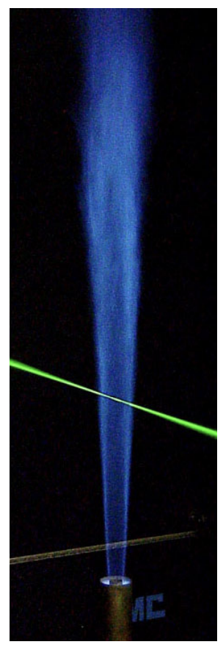
TNF Flames
C
D
E
F
Increasing
Extinction
https://tnfworkshop.org/wp-content/uploads/2019/02/SandiaPilotDoc21.pdf
Notes:
Table with 40 points in mixf, 10 points in variance, 10 points in L, 11 points in t
44000 total points * number of variables stored (e.g., temperature, etc.)
Note the high extinction: compare C versus F

Slide 11
TNF Flames
C
D
E
F
https://tnfworkshop.org/wp-content/uploads/2019/02/SandiaPilotDoc21.pdf
Notes:
Excellent agreement for flames C-E.
Flame F misses at heights 15 and 30 where the flame has the highest extinction.
(Need to test whether we are capturing things right with the progress variable, and whether there is sensitivity to the progress variable).
(May also want to test whether there is sensitivity to using Le=1 or the more general mixture averaged transport.)

Slide 12
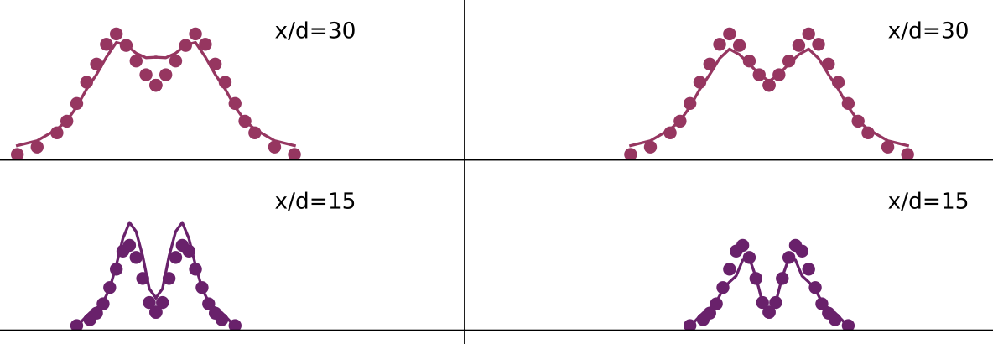
TNF Flames
F
Full table with unsteady
extinction
F
Partial table with
extrapolation of
steady burning
Notes:
“Full” table with unsteady extinction:
x/d=15 → overshoots the peaks and the centerline
x/d=30 → peaks slightly better and centerline worse than the ”full” table
Partial table: steady burning flames, but extrapolating the table for extinction
x/d=15 → undershoots the peaks, but catches the centerline
x/d=30 → same
Not solving through extinction and extrapolating the table is easier to compute and reduces the table size
Still, extinction is a really hard problem, and these results are quite good.

Slide 13
TNF Flames: PDF
Flame D
r=0 mm
r=12 mm
r=24 mm
Exp
P_{β}
Notes:
No noticeable difference when using linear or cubic interpolation.

Slide 14
TNF Flames: resolution
Flame D
nV=20
nL=19
n_{ξ}=3-80
nV=1-20
nL=1-20
n_{ξ}=5
Vary n_{ξ}
Vary n_{V}, n_{L}
Notes:
The table can be really course

Slide 15
TNF Flames: resolution
Flame D
Flame F
hi rez: 41, 11, 20
lo rez: 5, 1, 1
hi rez: 41, 11, 20
lo rez: 5, 1, 1
Notes:
The table can be really course
When nV = 1 we have no variance accounted for.

Slide 16
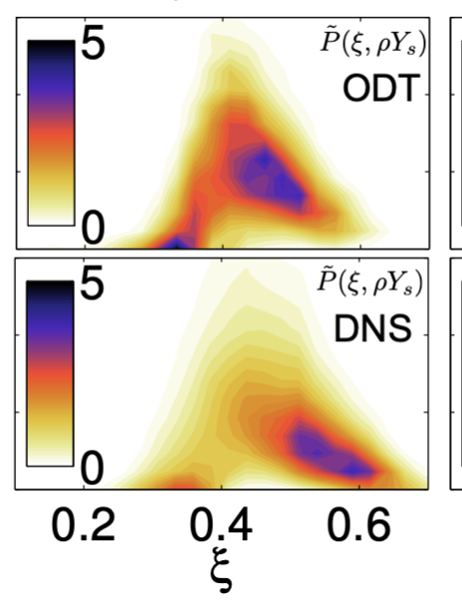
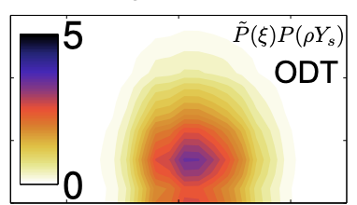
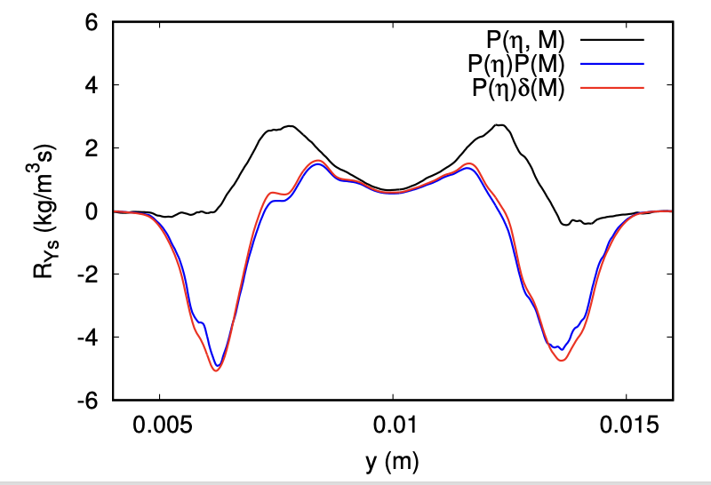
Joint PDF representation
ODT Simulation of a temporal ethylene jet with soot formation
ODT provides “resolved” profiles for T, Y_{i}, Soot → joint PDFs
A common modeling assumption:
Notes:
Left contour plots: ODT simulations → compare joint pdf with common assumption of independenc
Compute the mean soot rate versus position across the jet using the different PDF assumptions.
The blue → red is a good assumption (neglecting soot fluctuations)
But the black to blue assumption (neglecting independence between the soot and mixture fraction is a bad assumption, and gives wrong reaction rate results, including getting the sign of the reaction wrong

